Slide 1
European Elections
23-26 May 2019
Venue & Date
Speaker
Title
Unit
European Commission
DG
Notes:
This presentation has been prepared by the European Commission's Directorate-General for Communication.
It is meant to be used publicly and in a modular way, depending on the target audience, to inform about the European Union and the European elections so that citizens can take informed decisions on Europe's future.
This is part of the Union's legal and institutional responsibility.
It does not represent or aim at political campaigning.
Users of this presentations are nevertheless advised to check if there are certain legal restrictions and silence periods imposed by national law that would require them to avoid using certain elements of this presentations in a given period before the elections. These rules are known to be particularly strict in France and Spain. An overview of existing restrictions and silence periods compiled by DG COMM can be found here.
Contact: COMM-2019-ELECTIONS@ec.europa.eu – COMM.B.2 – Interinstitutional Relations, Corporate Contracts and Europe Direct Contact Centre (Head of Unit: Jens Mester).

Slide 2
European
Elections 2019
23-26 May
Content
Political context
Why vote
What Europe does
How to vote
How to engage
What after the Elections?
Contact the EU

Slide 3
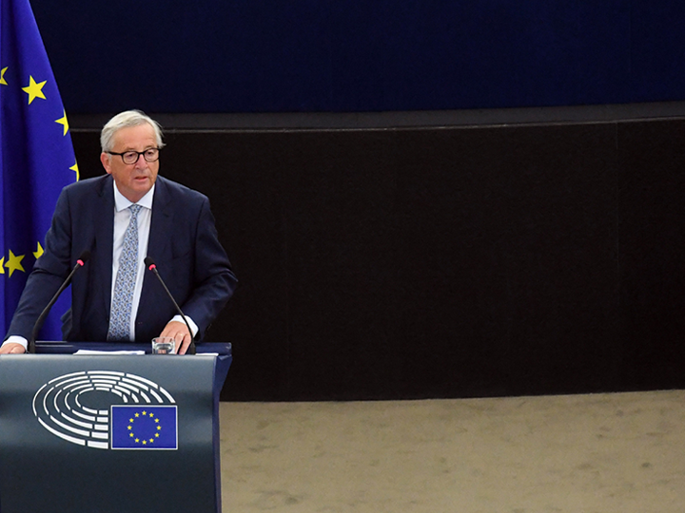
“I would like next year’s European Elections to be a landmark for European democracy”.
“Every European should be able to shape
the future of our Union”.
President Jean-Claude Juncker

Slide 4
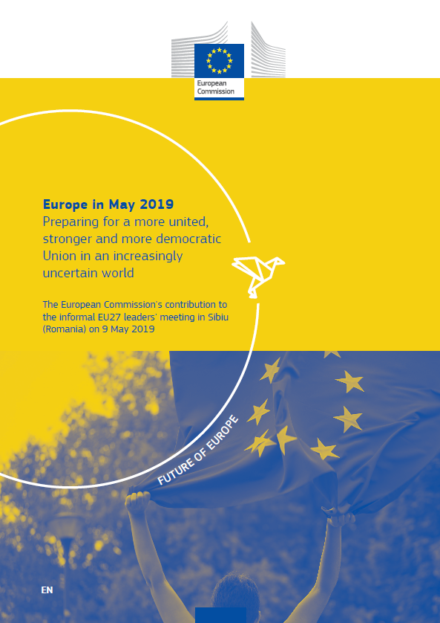
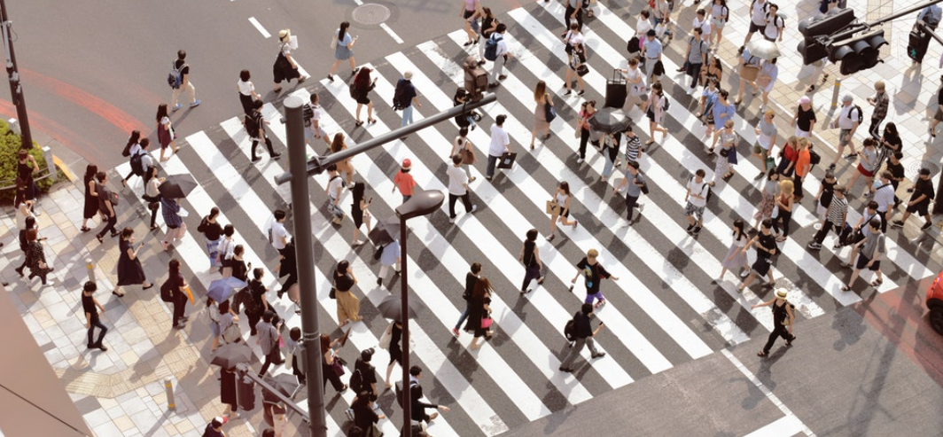
Future of Europe
Proposed priorities over the next five years:
Protective Europe
Competitive Europe
Fair Europe
Sustainable Europe
Influential Europe
Both the priorities and the way we explain them and engage with Europeans will be decisive in making our Union more united, stronger and more democratic.
Notes:
Europe in May 2019 - Commission contribution to the informal EU27 leaders' meeting in Sibiu (Romania) on 9 May 2019 (30 April 2019)
https://ec.europa.eu/commission/future-europe/commissions-contribution-informal-eu27-leaders-meeting-sibiu-romania-9-may-2019_en
Factsheets on the Commission’s 10 priorities (7 May 2019)
https://ec.europa.eu/commission/publications/factsheets-commissions-10-priorities_en
Report: Citizens’ Dialogues and citizens ’ consultations – key conclusions
https://ec.europa.eu/commission/files/citizens-dialogues-and-citizens-consultations-key-conclusions_en

Slide 5
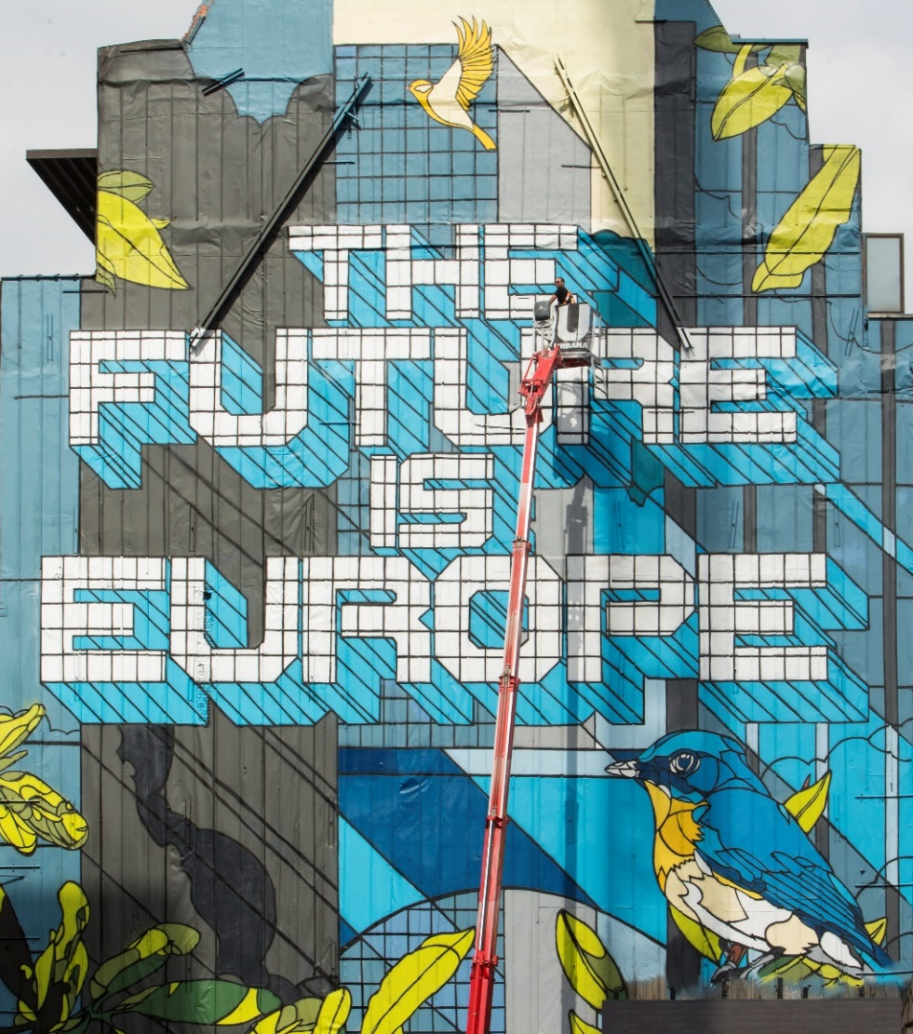
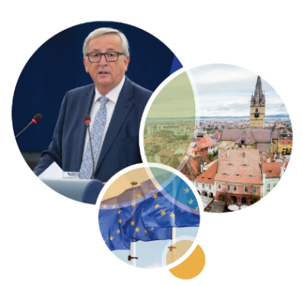
Commission proposals ahead of the elections
14 February 2018
Making the EU's work more efficient & enhancing the European nature and efficient conduct of the European Elections
Improving Lead Candidates approach
Composition of the EP & the EC
Citizens’ Dialogues
12 September 2018
State of the Union
Securing free and fair European Elections
Notes:
“Valentine’s Day” package – press release in all EU languages
http://europa.eu/rapid/press-release_IP-18-743_en.htm
Securing free and fair European elections (State of the Union 2018) – press release in all official EU languages
http://europa.eu/rapid/press-release_IP-18-5681_en.htm

Slide 6
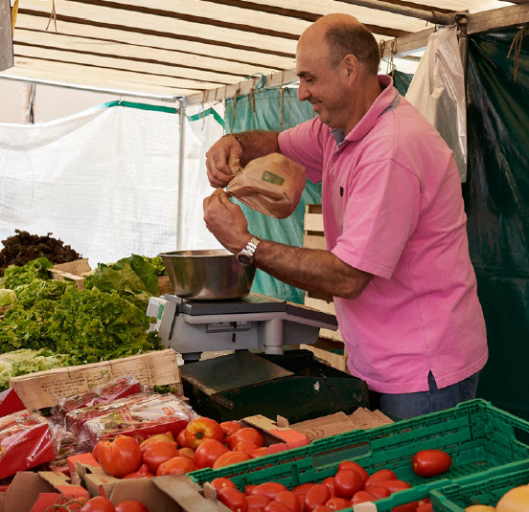
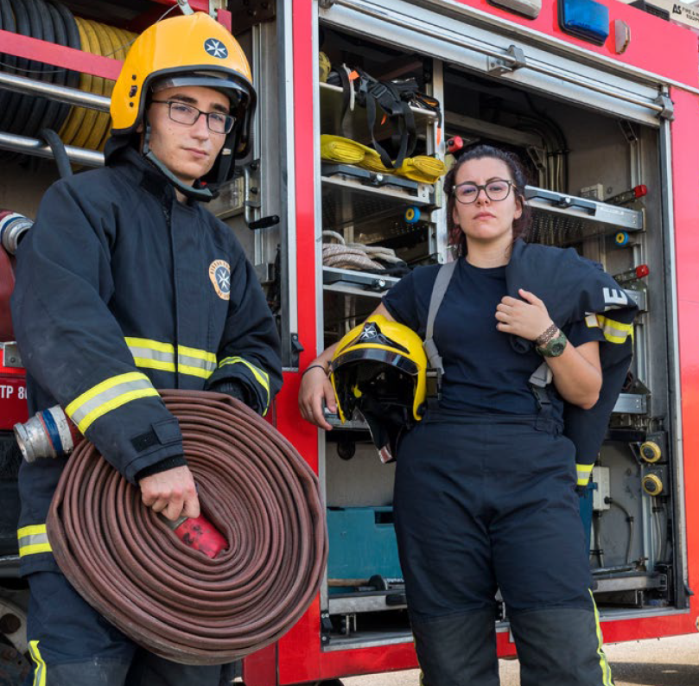
Why vote? To shape Europe's future!
1
2
3
Your vote influences how the European Union decides on matters that affect your daily life.
Your vote gives the European Union the strength to protect you and your family.
Your vote defends democracy.
Notes:
The European Union makes big decisions: how to grow the economy, how to curb energy use, how to make sure that the food we eat is safe. When you vote, you choose who makes these decisions and what they mean for the sort of world you want to live in. If you don’t vote, you have no say.
The world faces many challenges, from migration to climate change. But when problems are shared, solutions are more easily found. Our Union is leading the way in innovation and investment that, for example, we need to tackle climate change. And it is working to protect our way of life and our privacy. Your vote gives it the strength it needs to do that.
All around us, we see how unchallenged “truths” can turn diversity into division. And how fragile democracy can be. Our Union is based on a shared respect for fundamental rights and democratic principles. Your vote is your claim on those rights, for yourself and for others.

Slide 7
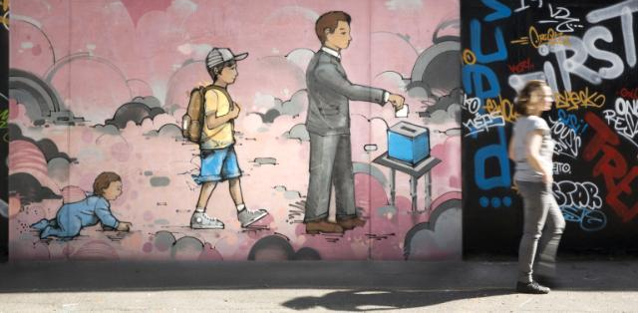
European Parliament: the voice of citizens
Powers
Legislative: passing laws, proposed by the Commission, together with the Council of the EU; deciding on international agreements, enlargements; reviewing the Commission's work programme and asking it to propose legislation;
Supervisory: democratic scrutiny of all EU institutions; electing the Commission President and approving the Commission as a body; examining citizens' petitions and setting up inquiries;
Budgetary: establishing, together with the Council, the EU budget; approving the Multiannual Financial Framework.
2014-2019: 751 Members
Post-Brexit: 705 Members
How many seats will each country have?
Notes:
More details on the European Parliament’s official website.

Slide 8
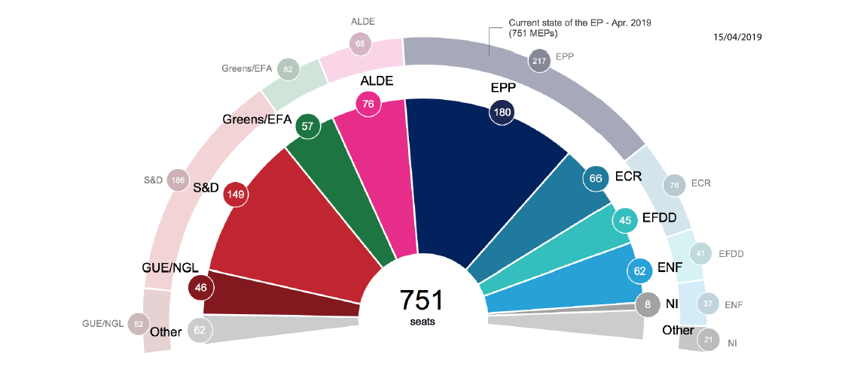
Seat projections
15 April 2019
(Source: Report on the developments in the political landscape, EP 2019)
Public and media attention high.
Lead candidates of political parties: Manfred Weber (EPP), Frans Timmermans (PES), Ska Keller and Bas Eickhout (Greens), Violeta Tomic and Nico Cue (European Left) and Jan Zahradil (ACRE/ECR), Liberals: Nicola Beer, Emma Bonino, Violeta Bulc, Katalin Cseh, Luis Garicano, Guy Verhofstadt, Margrethe Vestager.
Notes:
Regularly updated seat projections and many useful facts around in the Elections can be found in the Elections press kit:
http://www.europarl.europa.eu/news/en/press-room/elections-press-kit/5/projections-of-seats-of-next-parliament
Press kit of EP available at: http://www.europarl.europa.eu/news/en/press-room/elections-press-kit/1/facts-and-figures-on-electoral-process

Slide 9
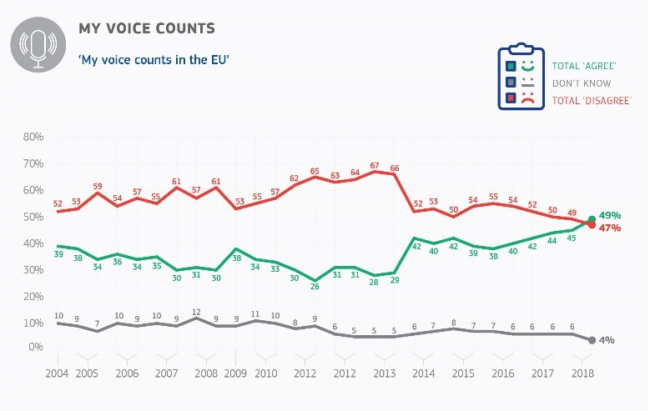
Public Opinion in the EU
In all EU Member States,
a majority of respondents
feel they are citizens
of the European Union.
The proportion of the population thinking that “their voice counts in the EU”
is the highest since 2004. (Source: Autumn 2018 Standard Eurobarometer)
Notes:
Autumn 2018 Standard Eurobarometer: http://ec.europa.eu/commfrontoffice/publicopinion/index.cfm/survey/getsurveydetail/instruments/standard/surveyky/2215

Slide 10
Trust in the EU
Trust in the EU at highest level
since 2014.
(Source: Autumn 2018 Standard Eurobarometer)
Notes:
Autumn 2018 Standard Eurobarometer: http://ec.europa.eu/commfrontoffice/publicopinion/index.cfm/survey/getsurveydetail/instruments/standard/surveyky/2215

Slide 11
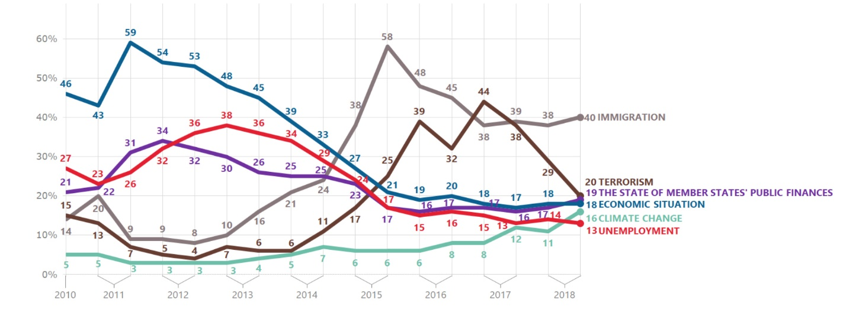
Most important issues facing the EU
(Source: Autumn 2018 Standard Eurobarometer)
40% Immigration
20% Terrorism
19% Public finances
18% Economic situation
16% Climate change
13% Unemployment
Notes:
Autumn 2018 Standard Eurobarometer: http://ec.europa.eu/commfrontoffice/publicopinion/index.cfm/survey/getsurveydetail/instruments/standard/surveyky/2215

Slide 12
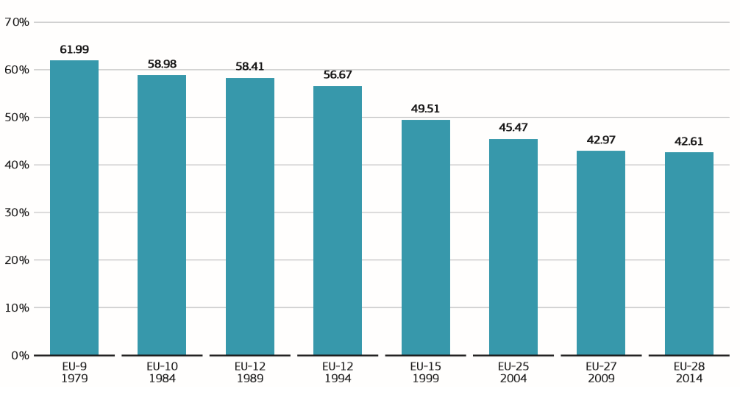
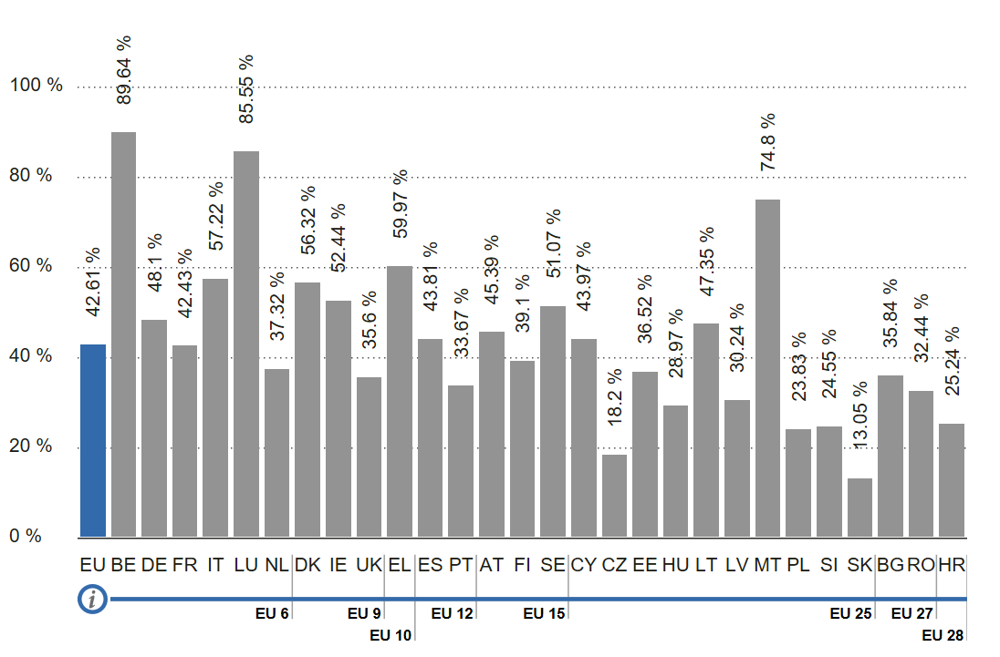
2014 European Elections turnout - general
Since 1979,
turnout in European Elections has fallen steadily
42,61% turnout in 2014 Elections
Yet, from 2009 to 2014, the downward trend
was significantly stemmed (-0.36 %).
2014 turnout results
by Member State
Notes:
Since the first direct elections in 1979, turnout in European elections had fallen steadily from 61.99 % in 1979 to 42.97 % in 2009. However, overall participation in the 2014 elections was only marginally lower than in 2009, dropping by 0.36 % (to 42.61 %), as compared with steeper drops of 2.5 % between 2004 and 2009 and 4 % between 1999 and 2004. Thus, the downward trend was significantly stemmed.
Report on the 2014 European Parliament elections, published by the European Commission: https://ec.europa.eu/info/sites/info/files/com_2015_206_en.pdf

Slide 13
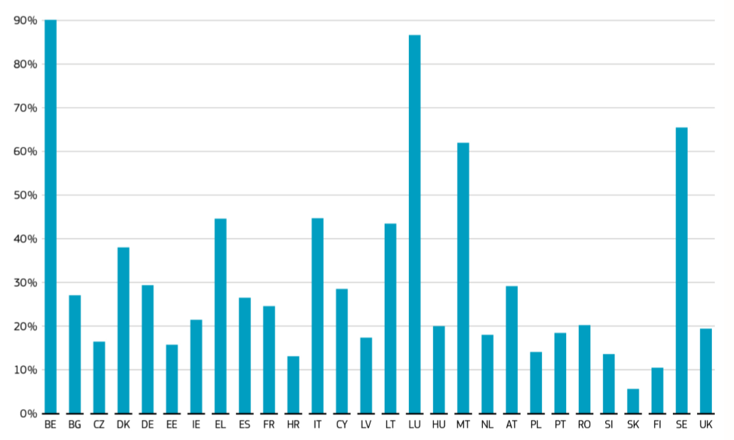
2014 European Elections turnout: Youth
(Source: Report on the 2014 European Parliament)
27,8% of 18-24 year-olds
voted in the 2014 Elections
51,3 % voted in the 55+ age group
Notes:
Report on the 2014 European Parliament elections, published by the European Commission: https://ec.europa.eu/info/sites/info/files/com_2015_206_en.pdf

Slide 14
Informed citizens
The next European Elections will be held in May 2019.
Which of the following would make you more inclined to vote in these Elections?
(Source: “Democracy and Elections” special EB, November 2018 – average EU28)
Being better informed about the EU’s impact on daily life is the factor most likely (43%) to increase motivation to vote in the European Elections.
Notes:
“Democracy and Elections” special EB, November 2018:
http://ec.europa.eu/commfrontoffice/publicopinion/index.cfm/Survey/getSurveyDetail/instruments/SPECIAL/yearFrom/2017/yearTo/2019/search/democracy%20and%20elections/surveyKy/2198

Slide 15
How does the Commission communicate?
The EC communicates on three fronts and in close cooperation with the EP,
in order to empower citizens to take informed decisions
What the EU does
Why and how to vote
How to engage

Slide 16
Communicating
What Europe does
One message, one voice, one logo

Slide 17
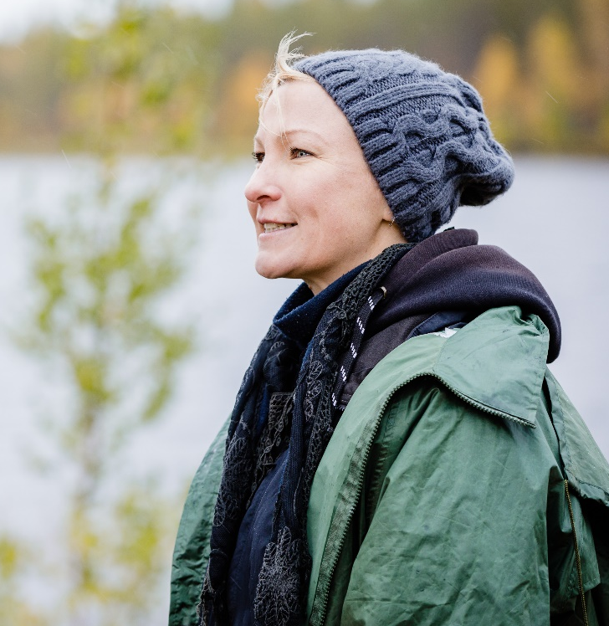
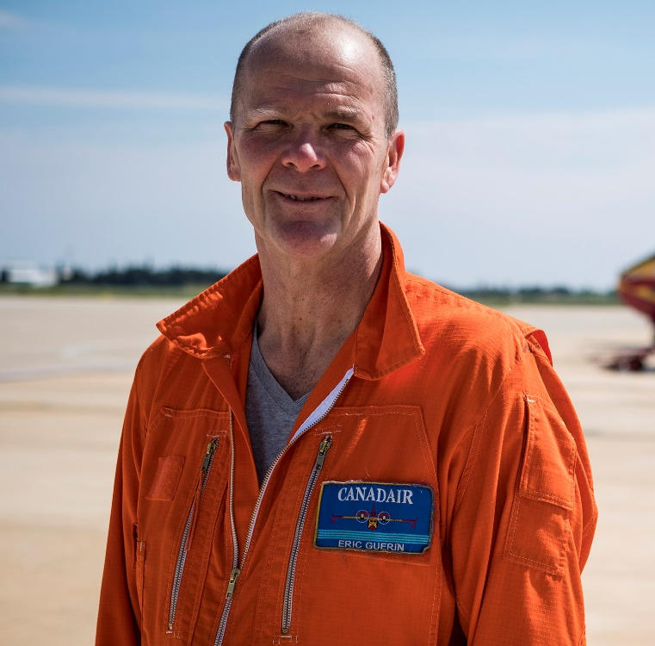
Three corporate campaigns
Showing real local stories & beneﬁciaries of EU-funded projects.
Reaching out to young people across Europe, inviting them to rediscover essential European values.
Highlighting people in action working on the ground for the protection of EU citizens.
www.europa.eu/investeu
www.europa.eu/euandme
www.europa.eu/euprotects
PLUS: A Day in the Life of an EU citizen
Series of short clips for each Member State,
showing how the EU is improving everyday life.
Notes:
InvestEU
www.europa.eu/investeu
#EUandMe
The Living Hostel by Matthias Hoene (Mobility)
https://europa.eu/euandme/content/living-hostel-directed-matthias-hoene_en
The Loner by Tomasz Konecki (Digital)
https://europa.eu/euandme/content/loner-directed-tomasz-konecki_en
Debut by Dalibor Matanić (Rights)
https://europa.eu/euandme/content/debut-directed-dalibor-matani%C4%87_en
Party Animal by Yorgos Zois (Skills and business)
https://europa.eu/euandme/content/party-animal-directed-yorgos-zois_en
Oona by Zaida Bergroth (Sustinability)
https://europa.eu/euandme/content/oona-directed-zaida-bergroth_en
The Key by Valerie Muller and Angelin Preljocaj (Fundamental values - United in diversity)
https://europa.eu/euandme/content/key-directed-valerie-muller-and-angelin-preljocaj_en
The Shape by Jaco Van Dormael (Freedom of speech and media pluralism)
https://europa.eu/euandme/content/shape-directed-jaco-van-dormael_en
EU Protects
Civil Protection: How Europe came together to fight forest fires
https://youtu.be/dauzWlcbavA Organised Crime: How Europe shattered a human trafficking ring https://youtu.be/LuoqDjrUPTw Rare Diseases: How the EU connected experts to treat epilepsy https://youtu.be/_nxis0PIE3A Extremism: How the EU is combatting radicalisation https://youtu.be/JmBtm1nUacE Integration: The journey of an asylum seeker https://youtu.be/1KA_g3fZymQ Border Protection: Patrolling the EU’s maritime border https://youtu.be/F0qZbFwFRYU
A Day in the Life of an EU citizen
https://audiovisual.ec.europa.eu/en/topnews/M-001712

Slide 18
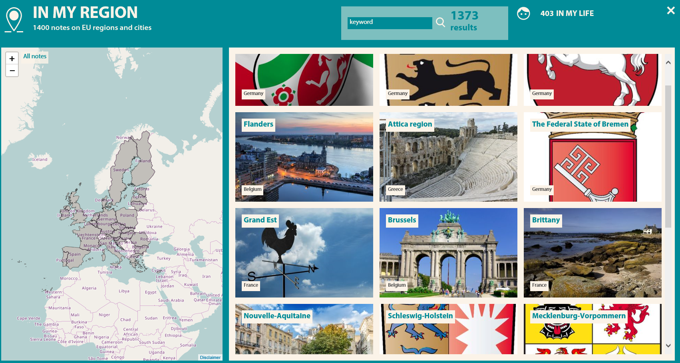
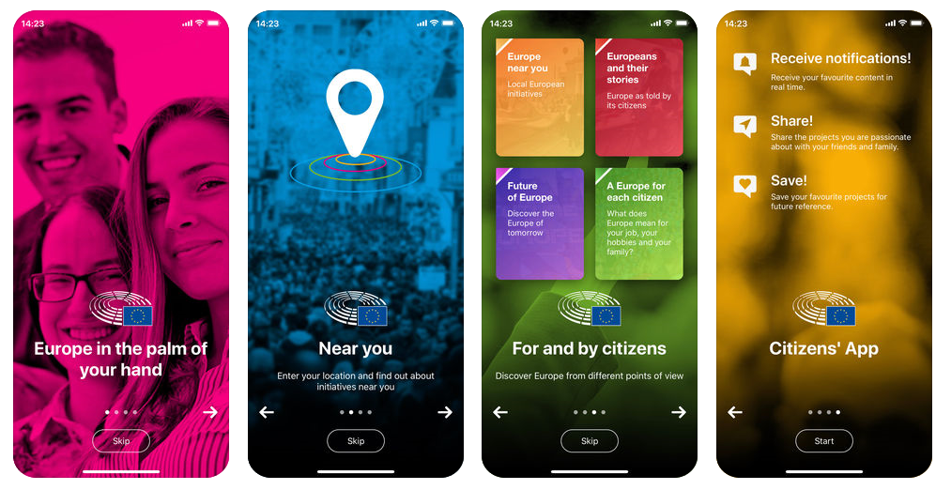
What Europe does
Factsheets on the Commission’s 10 priorities
EU projects
What Europe Does for Me
Citizens’ App
Notes:
Factsheets on the Commission’s 10 priorities (7 May 2019)
https://ec.europa.eu/commission/publications/factsheets-commissions-10-priorities_en
EU projects
https://ec.europa.eu/budget/euprojects/search-projects_en
https://ec.europa.eu/regional_policy/en/policy/communication/euinmyregion
https://ec.europa.eu/regional_policy/en/projects
What Europe Does for Me
A website providing around 2,000 examples of what Europe does for citizens in different thematic areas, cities and regions.
https://what-europe-does-for-me.eu
Citizens’ App “Europe at the palm of your hands” (including “What Europe Does for Me”)
http://www.europarl.europa.eu/at-your-service/en/stay-informed/citizens-app

Slide 19
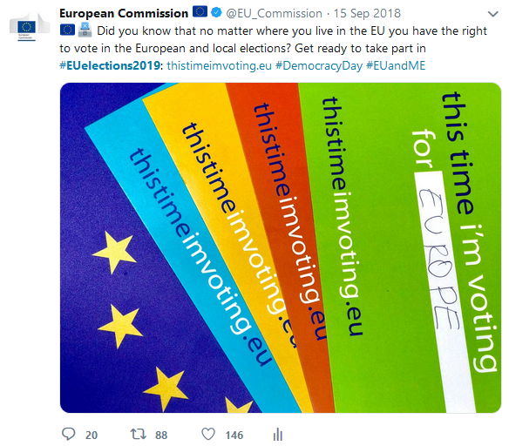
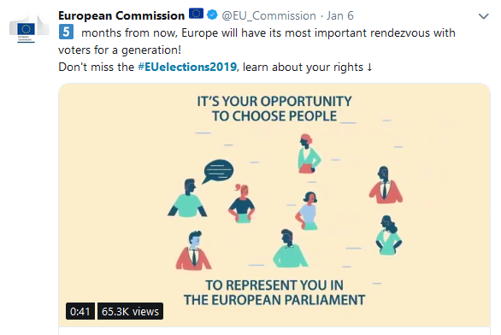
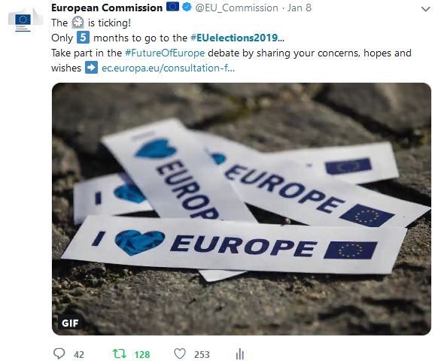
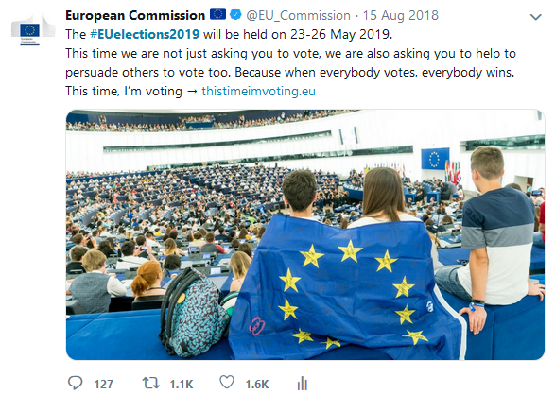
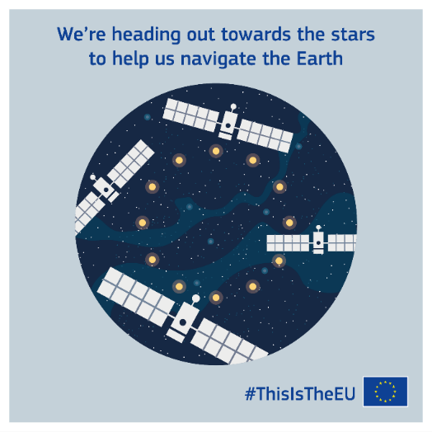
Social media: #EUelections2019
+100 European Elections-related contents since 2018.
96,000 engagements, 4 million Twitter impressions, 2 million Facebook/Instagram users reached.

Slide 20
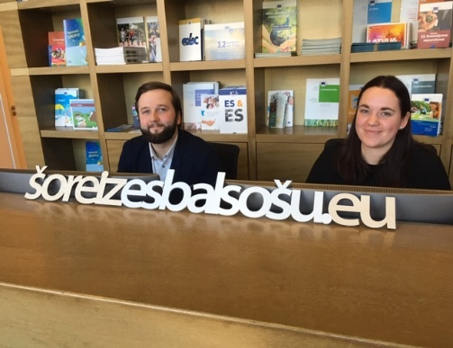
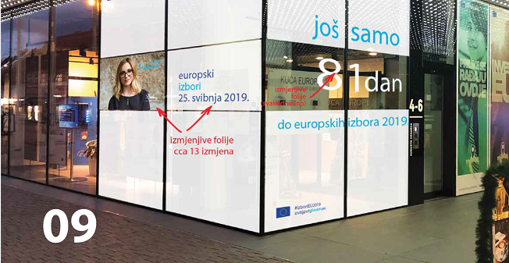
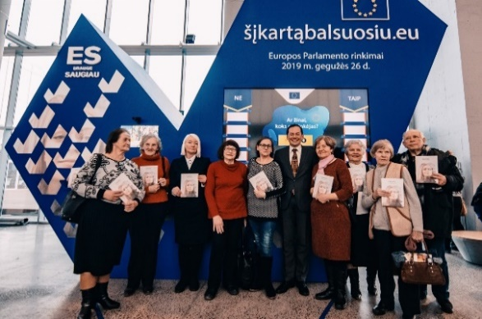
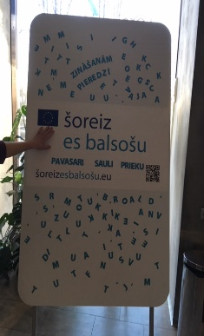
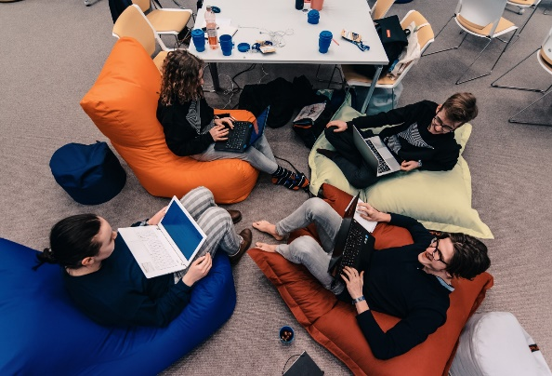
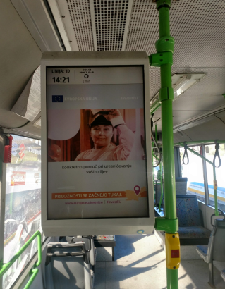
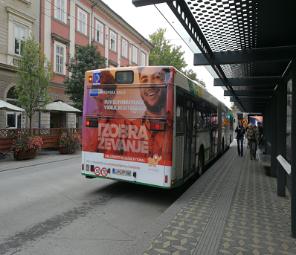
Cooperation in Member States
This time I’m voting - Riga
Elections countdown- Zagreb
This time I’m voting – Vilnius Book Fair
Hackathon - Vilnius
Public transportation – Germany
Public transportation – Ljubljana
EP Liaison Offices and EC Representations
are working together in all Member States.
They are at your disposal!

Slide 21
Mythbusting & countering disinformation
(Source: Flash Eurobarometer, February 2018; Special Eurobarometer, September 2018)
2018 Action Plan against Disinformation
Mobilising the private sector
EU-wide Code of Practice against disinformation
Raising awareness & improving societal resilience
Positive & objective communication
Notes:
Flash Eurobarometer, February 2018; Special Eurobarometer, September 2018
2018 Action Plan against Disinformation:
https://ec.europa.eu/commission/publications/action-plan-disinformation-commission-contribution-european-council-13-14-december-2018_en

Slide 22
Mythbusting & countering disinformation
Myths & facts on: EU budget, General Data Protection Regulation (GDRP),
Common Agricultural Policy (CAP), Copyright, Migration.
Mythbusting by EC Representations in Austria, Bulgaria, Croatia, Czechia (1,2),
Finland, France, Germany, Italy, Poland, Portugal, Slovakia, Sweden, UK.
EU vs Disinformation campaign

Slide 23
How to vote
What is the date of the Elections?
Can I vote by mail?
Where can I vote?
Can I vote by proxy?
What is the voting age?
Who are the candidates?
Where should I register to vote?
How can I vote in other countries?
Find all answers here:
www.European-elections.eu/how-to-vote
& on the Your Europe portal.
Notes:
Also, the EC has been very active in informing mobile EU citizens:
17 million mobile EU citizens living abroad
Outreach to top 10 expats groups (RO, PL, IT, PT, DE, BG, FR, ES, NL, EL)

Slide 24
How to engage
1,600 Citizens’ Dialogues – almost 600 cities – 27 Member States
EC Representations and 440 local Europe Direct Information Centres
Visitors’ centre / Experience Europe
Back-to-school (800 EU staff participated in 2018) and Back-to-University
New Learning corner for teachers and kids
Have your say – contribute to policy and law-making
European Citizens’ Initiative
Notes:
Citizens’ Dialogues
https://ec.europa.eu/info/events/citizens-dialogues_en
EC Representations in Member States
https://ec.europa.eu/info/about-european-commission/contact/local-offices-eu-member-countries_en
Europe Direct Information Centres
https://europa.eu/european-union/contact/meet-us_en
EC Visitors’ Centre
https://ec.europa.eu/info/about-european-commission/visit-european-commission/visitors-centre_en
Experience Europe (for example in Finland and Germany)
Learning Corner
A brand new website for teachers and kids
https://europa.eu/learning-corner/home_en
Better Regulation: Have your say - Contribute to EU policy and law-making
http://ec.europa.eu/citizens-initiative/public/welcome
European Citizens’ Initiative: Get a greater say in the policies that affect your lives.
http://ec.europa.eu/citizens-initiative/public/welcome

Slide 25
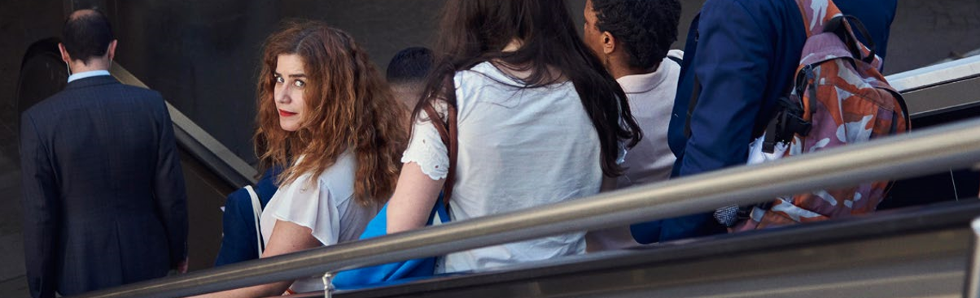
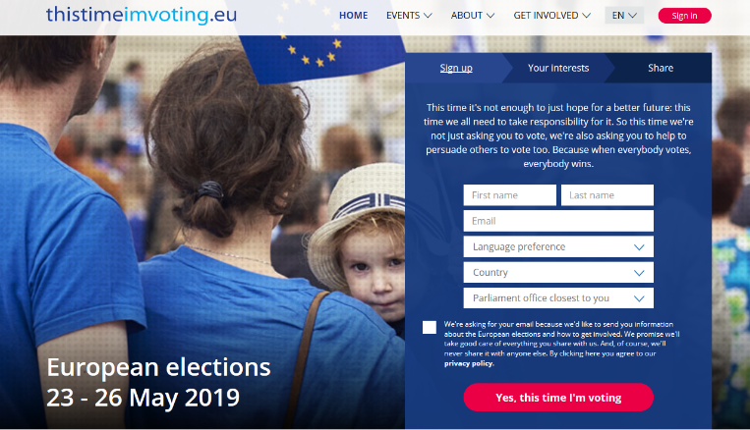
How to engage – This time I'm voting (EP)
1
Print a poster and display it
on your window or workplace
2
Register and share the date of the elections on Social Media
3
Spread the word
about what EU does
This time I’m voting
Notes:
"This Time I’m voting"/"Cette fois je vote"/"Diesmal wähle ich" is the EP’s main digital campaign platform to mobilize citizens ahead of the elections: www.thistimeimvoting.eu

Slide 26
How to engage – Choose your future film (EP)
Launched on 25 April 2019
Share the film from YouΤube and Facebook through your social media.
Notes:
http://www.europarl.europa.eu/news/en/press-room/elections-press-kit/5/choose-your-future
The short film is a nudge to take part in the upcoming European elections and to think about the future generations that will ultimately have to live with the consequences of this vote.
Directed by award-winning Frédéric Planchon, it documents the intense, beautiful and fragile moments when newborn children come into this world.

Slide 27
How to engage
Follow the EC’s Social Media accounts
Use the official European Elections hashtags:
#EUelections2019 #thistimeimvoting
Notes:
Facebook: https://www.facebook.com/EuropeanCommission
Twitter: https://twitter.com/EU_Commission
LinkedIn: https://www.linkedin.com/company/european-commission/
Instagram: https://www.instagram.com/europeancommission
Youtube: https://www.youtube.com/user/eutube

Slide 28
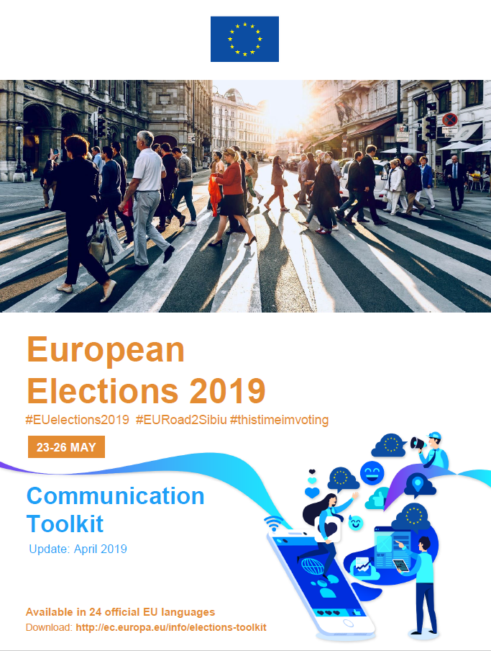
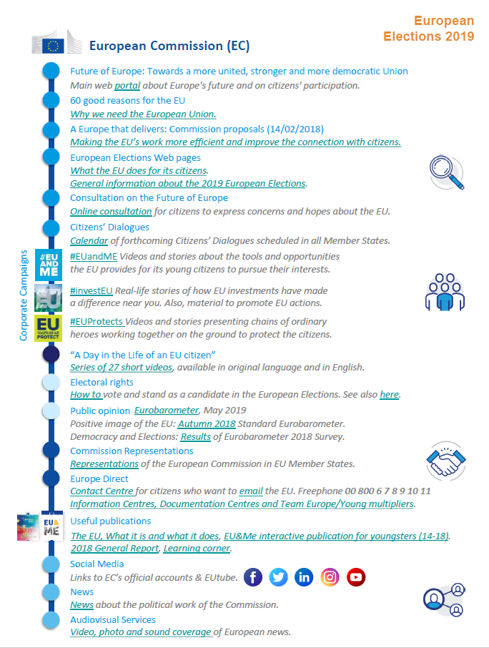
How to engage
Communication Toolkit
http://ec.europa.eu/info/elections-toolkit
Notes:
Use and distribute the Elections Communication Toolkit, available in all EU languages at: http://ec.europa.eu/info/elections-toolkit
It contains numerous resources and links to relevant information and materials about the European Union and the elections.

Slide 29
What after the elections? (1/2)
Key moments on the way to the next institutional cycle
(Source: EP)
Notes:
http://www.europarl.europa.eu/news/en/headlines/eu-affairs/20190417STO41782/european-elections-2019-what-s-next-infographic

Slide 30
What after the elections? (1/2)
Key moments on the way to the next institutional cycle
(Source: EP)
Notes:
http://www.europarl.europa.eu/news/en/headlines/eu-affairs/20190417STO41782/european-elections-2019-what-s-next-infographic

Slide 31
Questions?
Contact the European Union (in 24 languages):
Freephone from all EU countries: 00 800 6 7 8 9 10 11
From other countries: 0032 2 299 96 96 (standard rates apply)
Web form at https://europa.eu/european-union/contact_en
Notes:
Freephone from all EU countries: 00 800 6 7 8 9 10 11
Web form at: https://europa.eu/european-union/contact_en

